Slide 1
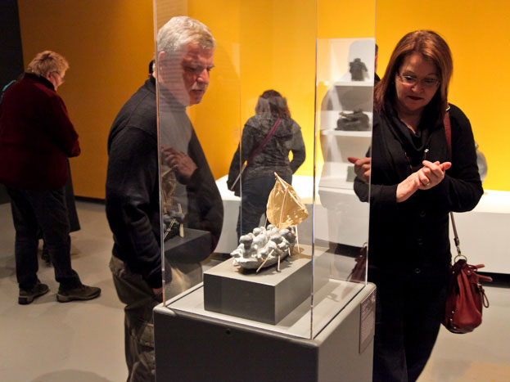


Interactive Glassbox
A transparent-display exhibition showcase

Slide 2
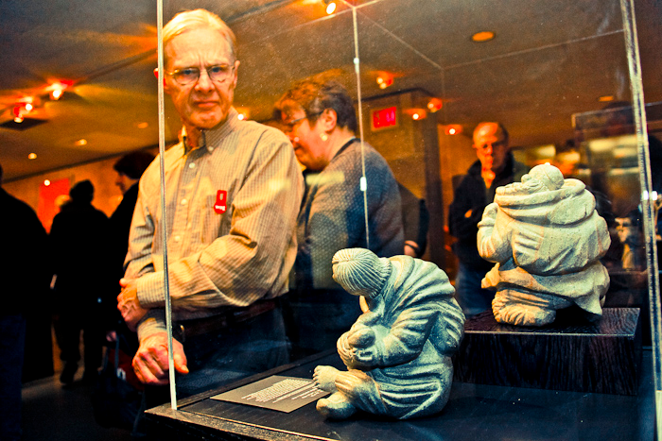

Slide 3
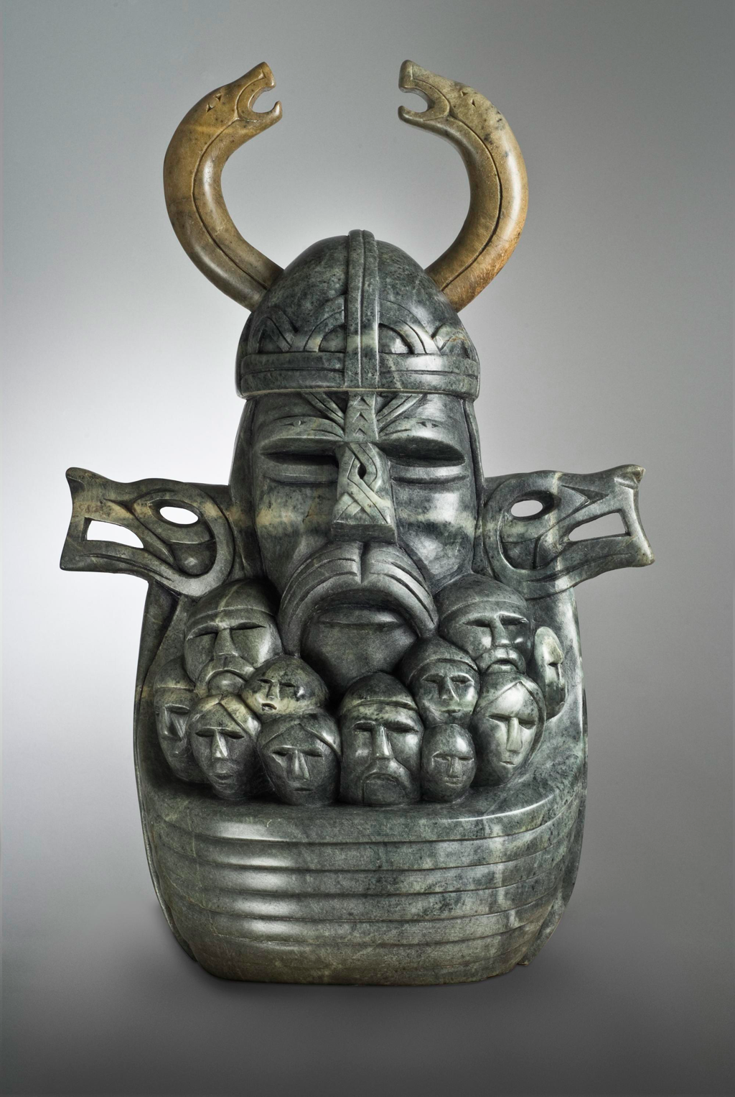
Name: Odin
Collection: Arctic Journeys
Artist: Abraham Anghik Ruben
Tribe: Inuvialit
Material: Brazilian Soapstone
Dimensions: 37 x 20.5 x 56 cm

Slide 4



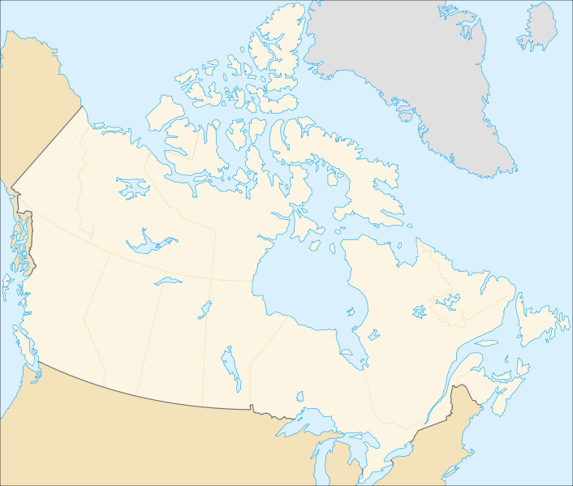
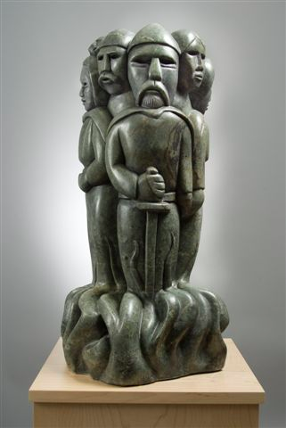
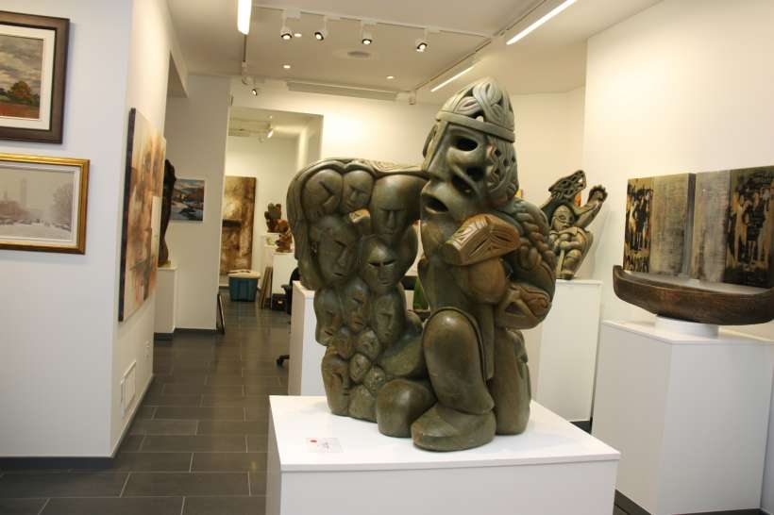




Slide 5
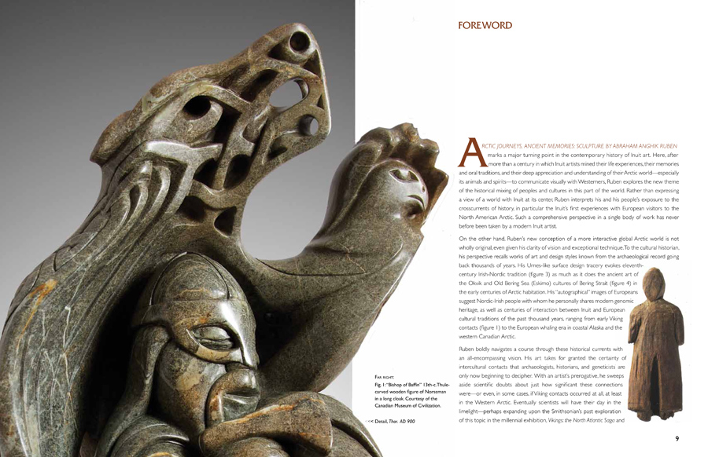

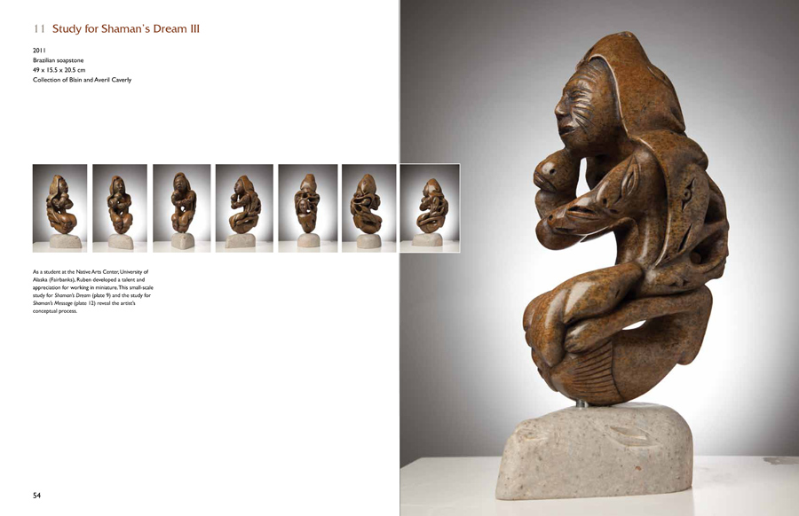


Slide 6
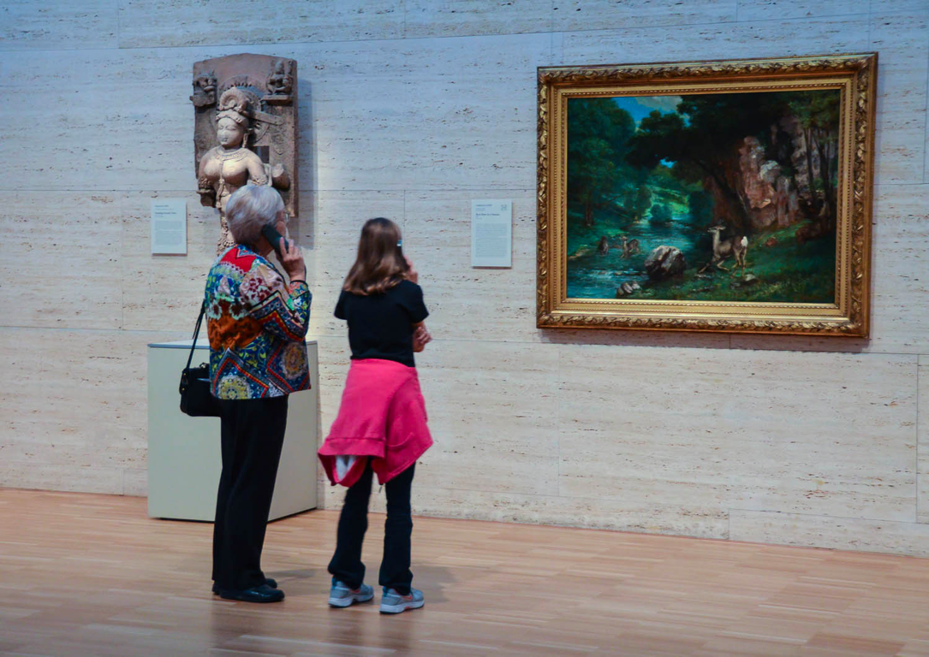

Slide 7
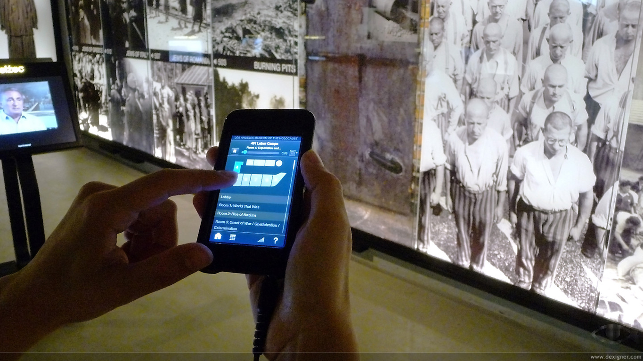

Slide 8
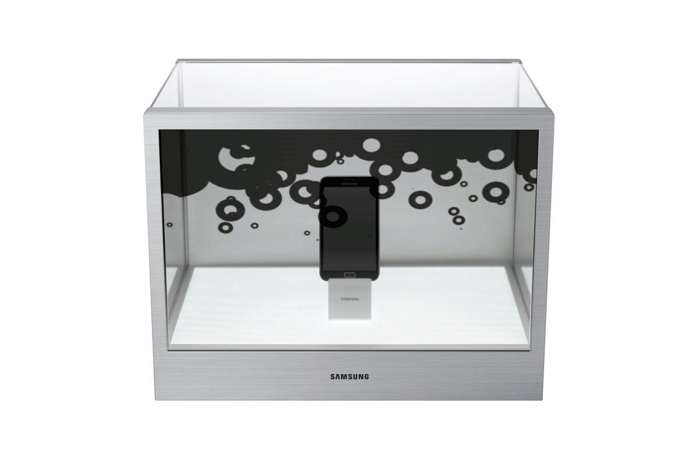

Slide 9




Judith (Jodie) Foster Xiang Guo Srikanth Krishnamashari Sridharan Juan David Hincapié-Ramos
Pourang Irani
Debra Fehr Angeliki Bogiatji

Slide 10
How to design a transparent-display showcase?
What are the technical challenges?
What is the impact on actual visitors to an art gallery?

Slide 11
Photos of the Fieldwork

Slide 12
Conceptual Map Public Displays

Slide 13
Conceptual Map Public Displays

Slide 14
Design Highlights (so far)
Design for Multiple Target Visitors
User Model (Attention-Aware Interfaces)
Balancing Act (Innovation -vs- Tradition)
Mobility

Slide 15
Technical Challenges (so far)
Hardware Design
- 360 view
- Mobility
Software Components
- Attention Estimator
- Monitoring and Data Collection
- Performance and Robustness
User Interface Components
- Binocular Highlights
- Attention-based UI

Slide 16
Measuring Impact (someday)

